Slide 1

UI Design Exercise
Senior UI Solutions Developer
28 September 2018 | Timothy Corbette

Slide 2
Agenda
The Challenge
Design Solution
The Technology Stack
Improvement Opportunities
Demo with Q&A

Slide 3
The Challenge:
Conference attendees need a way to easily navigate their daily agenda

Slide 4
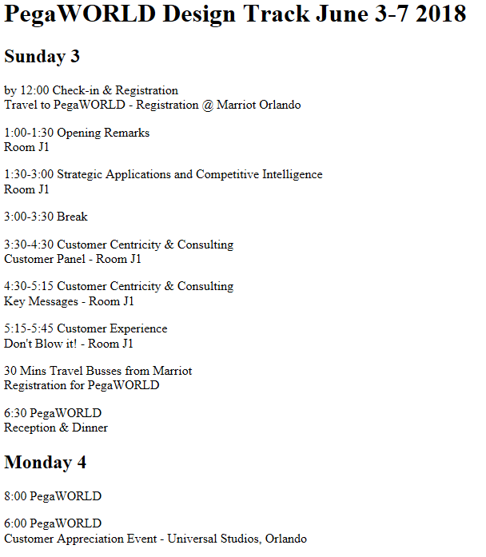
Limitations
Current Solution:
Limited display options
Not easily updated
Not customized to the user
Functionality is not extendable

Slide 5
The Design Solution:
Responds to the users’ needs

Slide 6
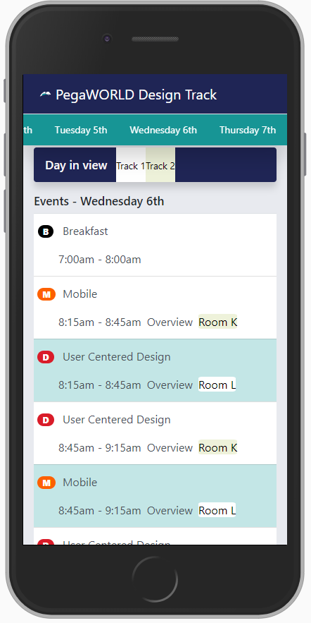
“At a glance” view on their smart phones during the conference
Navigate everything with one finger
No information loss or obscured

Slide 7
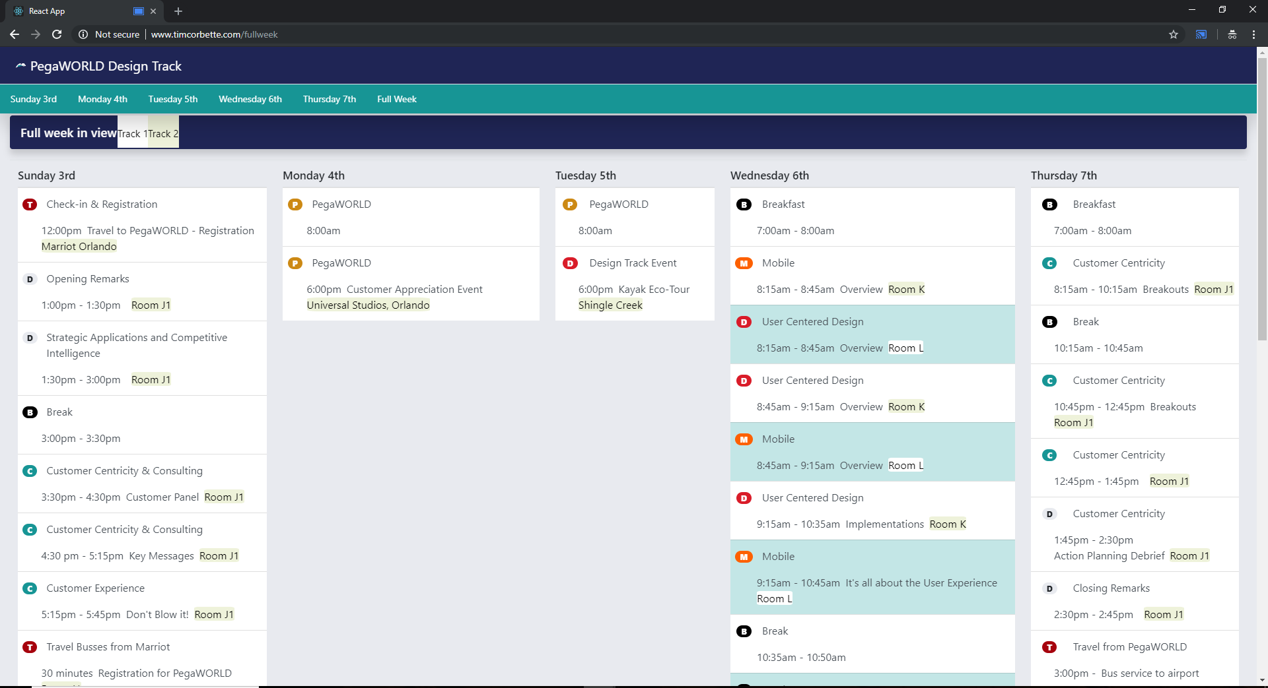
View the entire week’s agenda via laptop & projector
Control users’ access
Different views for projector and computers
Easy daily comparisons

Slide 8
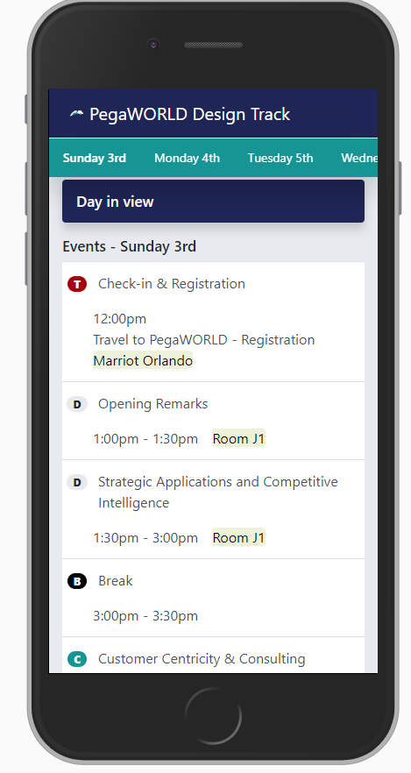
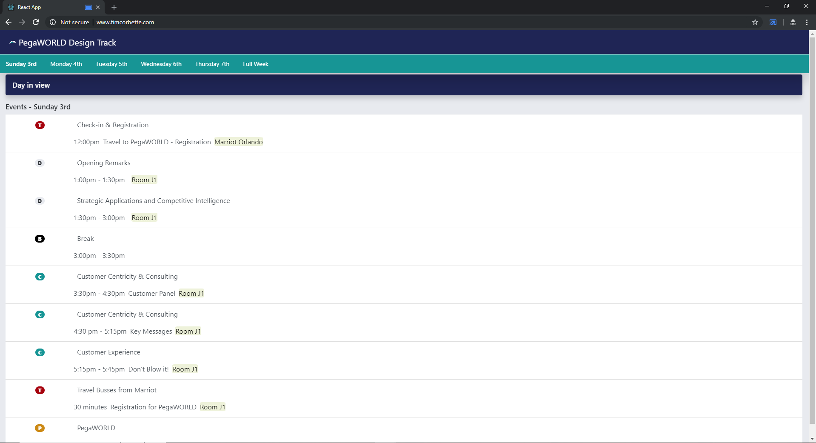
View a single days’ events (“day in view”)
Consistency across views (no re-learning)
Scroll menu for dates

Slide 9
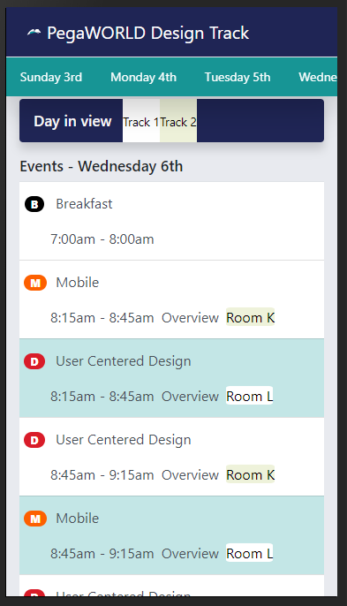
Visually distinguish the different categories of events on the design track schedule
Easily distinguishable
Color-coded tracks
Colorblindness: color and symbols

Slide 10
Technology Stack:
Scalable code

Slide 11
Code approach
Utilize open-source libraries and frameworks
Scalable architecture (prototyping to feature perfect)
Responsive grid and customizable framework
Out-of-the-box accessibility components

Slide 12
Opportunities:
Beyond the restraints

Slide 13
Improvement Opportunities
Google and iCalendar integration
Google maps integration
More detailed content for each event revealed on hover/click

Slide 14
Demo with Q&A
http://www.timcorbette.com/pega

